Slide 1
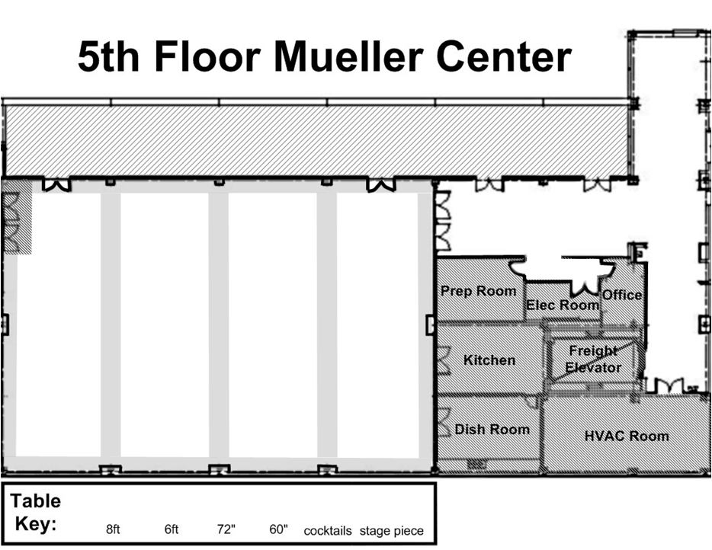
-4
-4
-4
-4
-4
-4
-4
-4
-4
8’
Bar
8’
8’
Bar
26
8’
Doors opened during cocktail hour
Escort
/cookies
8’
-21
-8
-11
Gift Bench
6
-6
1
-10
15
20
8’
8’
-12
Bar
11
-10
-12
-12
25
8’
7
-12
2
Dance Floor
21’ x 27’
16
21
-10
Erin Kisak & Tyler Hodgins
June 3, 2017
Pipe & drape
-10
17
-9
8
8
12
3
-10
22
8
-8
-12
-16+hc
8’
13
-10
Tray
cookies
9
-11
4
18
23
-10
-11
Pipe & drape
24
-8
14
-8
5
19
10
-7
-8 + hc
dj
-10
72”
60”
Misc. Key
coffee
C
C
C
C
C
C
C
C
C
C
C
C
C
8’
6’
C
6’
6’
Stage
Stage
S
S
Stage
S
Podium/ P&D/ Projector
Chair/ Misc.
Screen
Cafe

